Slide 1


Final Year Project
Phish Net
(Phishing Simulation Toolkit)
Supervised By: Dr. Jawaid Iqbal (Asst. Professor)

Slide 2
Project Team
Ali Kayani (37539)
Umar Waqar (27668)

Slide 3
Table of Content
Introduction and Background
Literature Review and Summary Table
Problem Statement
Methodology
Progress Report Summary
Requirements
Software System (Design + Implementation + Testing)
Endeavour (Team)
Next Steps
Prototype / Report

Slide 4
INTRODUCTION AND BACKGROUND

Slide 5
Introduction and Background
In today’s world, the digital landscape is full of vulnerabilities
Especially phishing attacks - the most pervasive
Exploiting human vulnerabilities more than technological ones.

Slide 6
Introduction and Background
In Pakistan — we suffer due to the lack of accessible, realistic, and localized training tools.
Guiding through experience to tackle these pervasive phishing threats.
Phish Net — scalable, customizable & realistic.

Slide 7
Introduction and Background
Guaranteeing Reporting & Training for organizational security.
Simulating real-world phishing attacks in controlled sandbox environment.
Monitoring each and every user’s interactions.
Generating detailed and thorough analytics.

Slide 8
Market Survey and Summary Table
There are several well-known phishing simulation platforms currently dominating the global cybersecurity training market.
Notable among them are:

Slide 9
Market Survey and Summary Table
Competition (International) — expensive, not customizable, unlocalized, limited scope.
Phish Net — scalable, customizable & realistic.
Phish Net — dynamic campaigns, user management, RBAC, and real-time user interactions.

Slide 10
Market Survey and Summary Table
KnowBe4 – security awareness training, simulated phishing attacks & vast template library and analytics.
Cofense (formerly PhishMe) – threat management & user behaviour tracking.

Slide 11
Market Survey and Summary Table
Limitations of Existing Products
While these platforms are robust, they present the limitations:
High costs and subscription fees.
Lack of localization for our regional contexts.
Little to no template customization. Limited Scope.

Slide 12
Market Survey and Summary Table
Issues of Existing Products
Dependence on foreign cloud infrastructure
Data privacy concerns
Lack of Modularity
No Customization

Slide 13
Market Survey and Summary Table
Comparative Analysis
For a brief comparison following could be viewed:
Features | KnowBe4 | Cofense |  | Proofpoint |  | Phish Net
Local Language Support | ✘ |  | ✘ | ✘ | ✔
Custom Template Creation | ✔ | ✔ |  | ✘ |  | ✔
Behavioural Analytics | ✔ | ✔ |  | ✘ |  | ✔
API Integration | ✔ | ✘ |  | ✔ |  | ✔
Deployment Options | Cloud | Cloud |  | Self-hosted |  | Cloud / Self-hosted
Cost Efficiency | ✘ | ✘ |  | ✔ |  | ✔

Slide 14
Problem Statement
Problem Statement
Organizations in Pakistan lack access to a secure, affordable, and locally adaptable phishing simulation platform.
Unrealistic real-world phishing attacks relevant to the regional context.

Slide 15
Problem Statement
Lack of customizable templates and dynamic campaign options.
Not generate behavioural insights through detailed analytics.
Lack of control and customization for management.

Slide 16
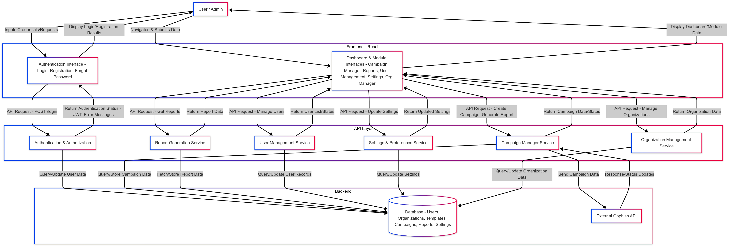
Methodology

Slide 17
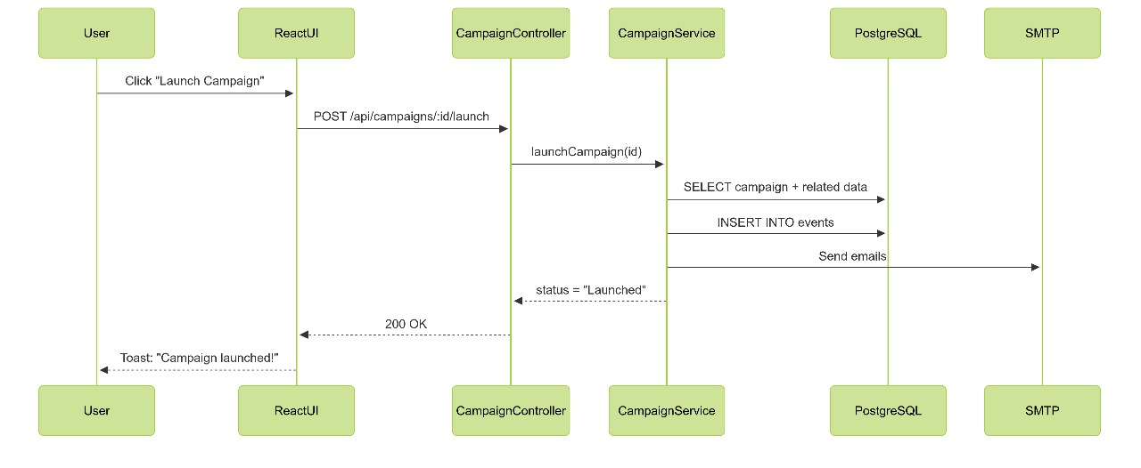
Methodology

Slide 18
Methodology
Project Explanation:
User Authentication/Login
User (Admin or Org Rep) logs into the platform securely using RBAC-controlled access and MFA.
Campaign Creation
Admin defines phishing campaign parameters such as target groups, email templates, timing (burst/batch), and scenarios.
Email Template Customization
User selects or creates a phishing email template, optionally embedding tracking pixels and redirection links.
Recipient Selection
User uploads or selects predefined user lists, often organized by department or role.

Slide 19
Methodology
Schedule Campaign
Campaign is scheduled to run immediately or at a defined future time.
Campaign Launch
Backend communicates with relevant APIs and initiates email delivery.
Phishing Email Delivered to Target
Emails are sent to selected recipients.
User Interaction Tracking (Open/Click/Submit)
Real-time tracking captures whether the recipient opens the email, clicks the link, or submits credentials.
Data Stored in PostgreSQL
Interaction data is logged into the PostgreSQL database for analysis.

Slide 20
Methodology
Analytics dashboard displays campaign effectiveness, user vulnerabilities, and statistical metrics.
Security Feedback and Recommendations
Automated feedback to users and recommending improvement & trainings.

Slide 21
PROGRESS REPORT SUMMARY

Slide 22
Requirements
List of Different Users:
Super Admin
Manager
Admin
IT Department
Cyber Consultant
Creator
Tutor
Team Lead
User

Slide 23
Requirements
Functional Requirements:
User Registration and Authentication (RBAC)
Campaign creation and email template management
Email scheduling (batch, burst, normal modes)

Slide 24
Requirements
Functional Requirements:
Phishing scenario deployment
Reporting and analytics dashboard
Real-time of email tracking (open, click, submit)

Slide 25
Requirements
Non-Functional Requirements:
Scalability: multiple organizations and user groups concurrently
Security: unauthorized access and data breaches
Usability: Intuitive UI/UX environment

Slide 26
Requirements
Non-Functional Requirements:
Performance: Real-time tracking and minimal latency
Maintainability: Modular codebase for easy updates
Availability: High uptime and reliable hosting

Slide 27
Design
Deployment Diagram
- Hardware/Software Components

Slide 28
Design
Detailed Design
UML Diagrams
ERD (if DB used)
etc.

Slide 29
Implementation
Development Tools & Technologies
- Frontend:
React.js
– For building the user interface
Vite
– Fast build tool and development server
Tailwind CSS
– Utility-first CSS framework for styling

Slide 30
Implementation
- Database:
PostgreSQL
– Relational database management system
- Security & Authentication:
JWT (JSON Web Tokens)
– Token-based
OAuth
– Open standard for access delegation
Google reCAPTCHA
– Bot detection and spam prevention

Slide 31
Implementation
- Containerization:
Docker
– Containerization and deployment
GitHub
– Source code repository and version control
GitHub Actions
– CI/CD automation tool
- Backend:
Express.JS
– Backend web framework

Slide 32
Implementation
ShadCN/UI – Component library for Tailwind-based UIs
Lucide React – Icon set used in UI
Backend (Express.JS):
Express.JS REST Framework – creating REST APIs
Express.JS CORS Headers – handle cross-origin requests

Slide 33
Implementation
Components
Authentication System – Login, registration, MFA, and token management
Email Campaign Manager – Interface for phishing campaign creation and scheduling
Real-Time Tracker – Tracks email interactions
Dashboard Analytics – Provides campaign statistics and engagement metrics
Template Builder – Customizable emails and pages

Slide 34
Implementation
Web Services / APIs
Google reCAPTCHA API – For bot prevention on login/registration forms
OAuth 2.0 Providers (e.g., Google) – For secure federated login
Custom REST API – Secure communication between frontend and backend

Slide 35
Implementation
Hardware & Software Components:
Following are thew hardware and software intakes that are required by the project:
Hardware:
Minimum: 8 GB RAM, i5 Processor, 2 GB SSD
Average: 8 GB RAM, i5 Processor, 250 GB SSD
Recommend: 16 GB RAM, i7 Processor, 500 GB SSD

Slide 36
Implementation
Software:
Frontend: React, Tailwind CSS, Vite
Backend: Django (Python), Database
Database: PostgreSQL
Tools: Docker, GitHub, GitHub Actions, Jest, Cypress

Slide 37
Testing
Testing Strategy & Approaches:
1. Testing Objectives
Ensure system security, accuracy, and robustness
Validate RBAC. Confirm seamless integration
2. Tools Used
Jest – Unit testing frontend components
Postman – API integration and security testing
OWASP ZAP – Automated security scans
Cypress – End-to-end and UI interaction testing

Slide 38
Testing
3. Types of Testing Conducted
Unit - Tested individual components
(e.g., form validation, API responses)
Integration - End-to-end testing with real-world phishing
Security - XSS, CSRF, SQL Injection, and session hijack
Usability - Interface tested with non-technical users

Slide 39
Testing
4. Sample Test Cases
Analytics Dashboard Accuracy – Ensure real-time updates reflect actual clicks
ReCAPTCHA Check – Prevent automated login attempts
5. Results & Observations
All critical paths passed (login, campaign, tracking, RBAC enforcement)
Sec. vulnerabilities - WAF, token auth, rate limits

Slide 40
ENDEAVOUR

Slide 41
Endeavour
Member Roles
- Ali Kayani
APIs
Database
GUI (UI/UX)
System Architecture
Project Management
Quality Testing/Assurance
Documentation
- Umar Waqar
Front-end
Back-end
Database

Slide 42
Endeavour
Software Development Lifecycle
1. Development Methodology: Agile
Weekly sprint planning and review sessions
2. Requirements Gathering
Functional needs & non-functional expectations
3. System Design
Modular, scalable client-server architecture
4. Development Phases
Frontend (React + Vite + Tailwind)
Backend (Django REST + Integration)

Slide 43
NEXT STEPS

Slide 44
Work Breakdown Structure
Front-End
Authentication
User Management System
User Profiles
User Privileges
User Dashboards
Back-End
Database
API Integration
Back & Front Linkage
Notification Mechanism
Email Sending
Alerting
Template Engine
Email Builder
Sample Templates
Template Import/Export
Analytics
Reporting
Phishing Campaigns
Simulations
Automation
Evaluation
Testing
Debugging & Improvements

Slide 45
Challenges
Ensuring Email Deliverability & Avoiding Spam Filters
Managing SPF, DKIM, and DMARC records for domain verification.
Evading spam detection algorithms. Not Blacklisted.
Deliverability - Gmail, Outlook, and corporate mail clients.
2. Developing User-Friendly & Robust Interface
Balancing intuitive design with the technical complexity of phishing campaign controls.
Implementing dynamic visualizations for analytics and reporting (charts, timelines).

Slide 46
Challenges
3. Ensuring System Integrity
Enforcing secure authentication using JWT and Multi-Factor Authentication (MFA).
Implementing CAPTCHA and rate-limiting on high-risk routes.
4. Ensuring Access Controls and Privileges
Implementing strict Role-Based Access Control (RBAC) across all modules.
Conducting privilege escalation testing FOR Acs.
5. Scalability Across Organizations & Roles
Designing a multi-tenant architecture with organization-level

Slide 47
PROTOTYPE & REPORT

Slide 48
Prototype
Core Modules Developed
Graphical User Interface (GUI):
Designed using React with Tailwind CSS for a clean, responsive layout.
Authentication Mechanism:
JWT-based login system. With MFA, RECAPTCHA
Notification Mechanism:
Real-time feedback for campaign results and system alerts.

Slide 49
Prototype
Dashboards:
Role-specific dashboards for every user
Campaign statistics, email interaction alerts.
Backend & Security Foundations
User Profiles & Privileges:
Implemented Role-Based Access Control (RBAC).
Database & Backend:
Backend - Django REST. Database – Postgre SQL

Slide 50
Prototype
Reporting & Analytics:
Auto-generated reports with export options (PDF/CSV).
Prototype Validation:
Fully functional modules for testing phishing scenarios in a controlled environment.

Slide 51
Report
Chapter 1: Introduction
Chapter 2: Literature Review / Market Survey
Chapter 3: Requirements and Design
Chapter 4: Implementation and Test Cases
Chapter 5: Experiment Results and Analysis
Chapter 6: Conclusion & Future Direction

